Slide 1
CSE 247
Simulating Heterogeneous Consumer Agents from Transactional Data using GEPA
Team Members: Jeshwanth Bheemanpally, Yash Malegaonkar,
Alec Raymond, Professor Yi Zhang

Slide 2
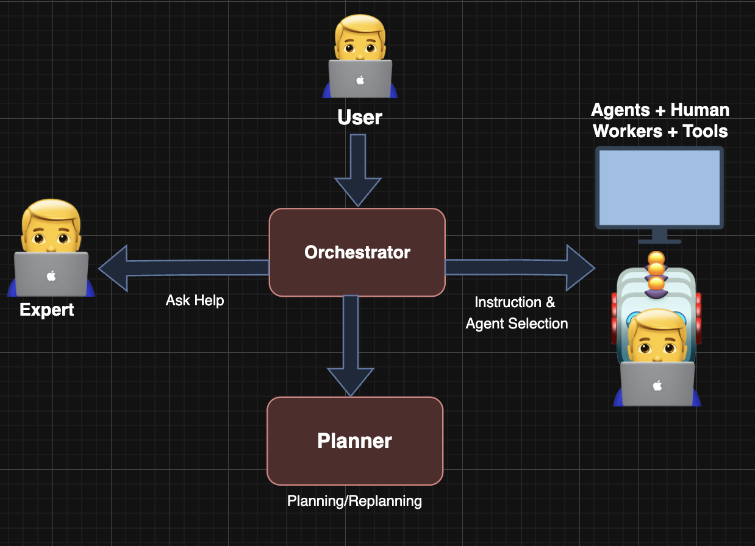
Introduction and Motivation
How can we best simulate an expert human agent?
A human in the loop helps agentic systems from getting stuck in the wrong problem space.

Slide 3
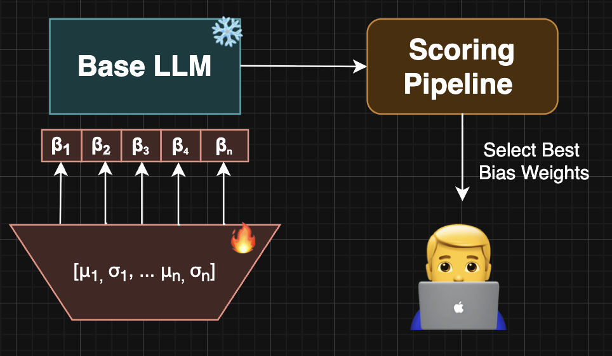
Introduction and Motivation
Solution: Perturb the Bias
Create a random distribution of perturbed bias weights
Within this distribution of biases, we can find different personalities, introducing variety into the approach of an agentic workflow, hopefully leading to “golden paths” towards the correct solution.

Slide 4
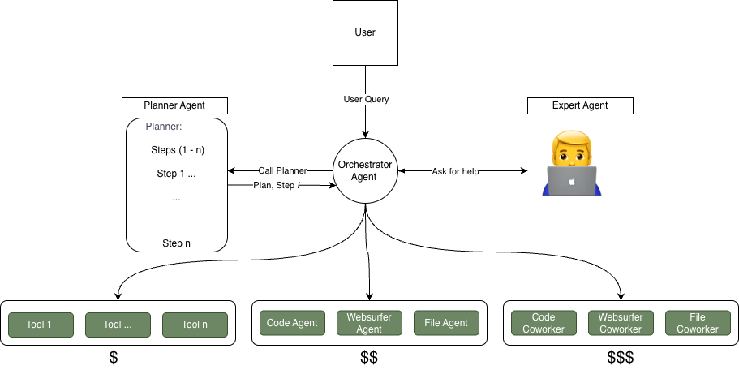
Is it an expert?
How do we integrate this simulated human into an agentic framework?
We chose smol-agents, a lightweight framework that allows an Orchestrator to call many agents sequentially, based on the problem given.

Slide 5
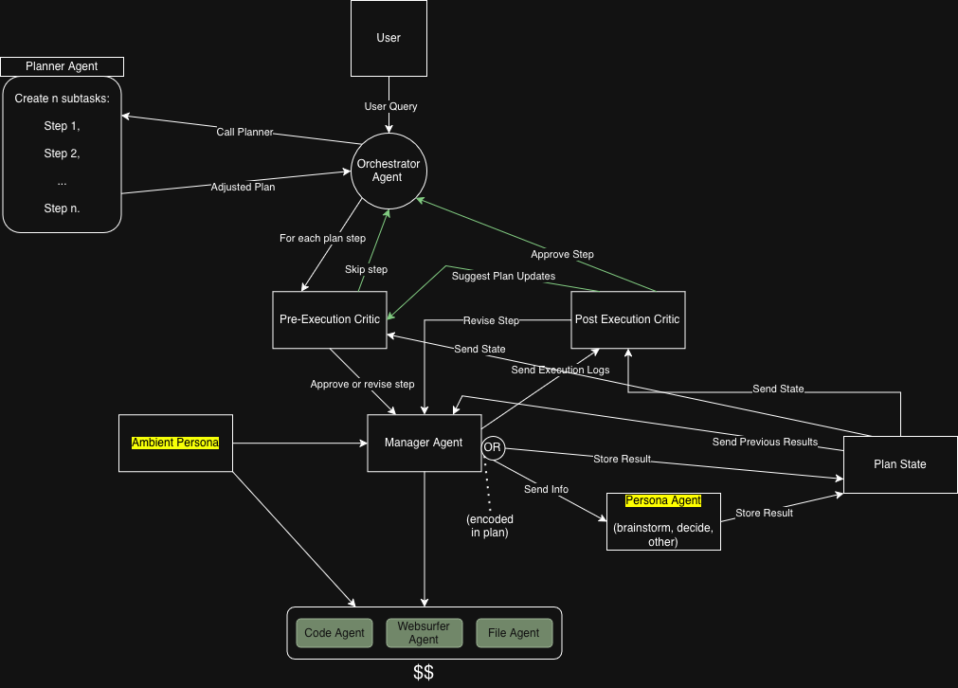
The agent isn’t an expert.
It’s a personality.

Slide 6
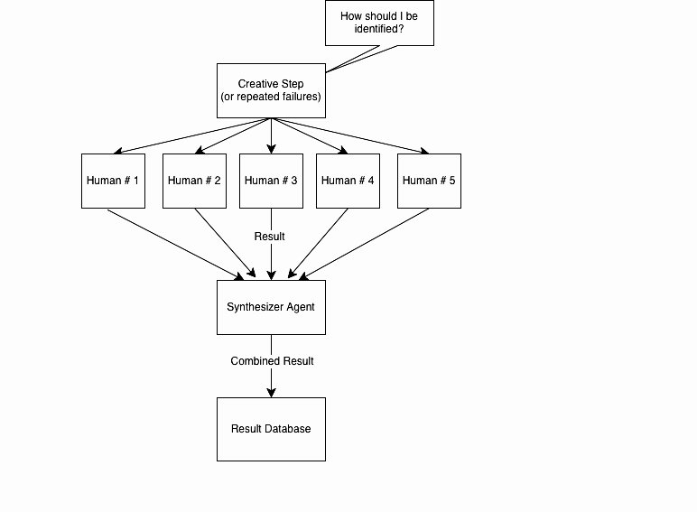

How can we best utilize a variety of personalities?

Slide 7
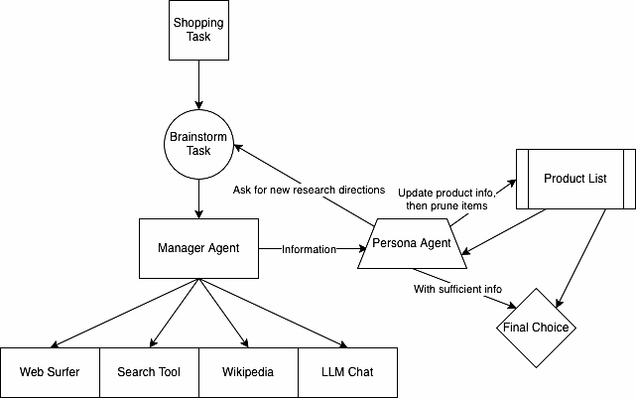
GAIA out. OPeRA in.
GAIA includes tasks which stress reasoning, tool-use, and multi-modal capabilities of agentic systems.
“Easy for humans, hard for LLMs”
OPeRA: Observation, Persona, Rationale, and Action
Connects online shopping actions to user rationale
Personalized Shopping Recommendations

Slide 8
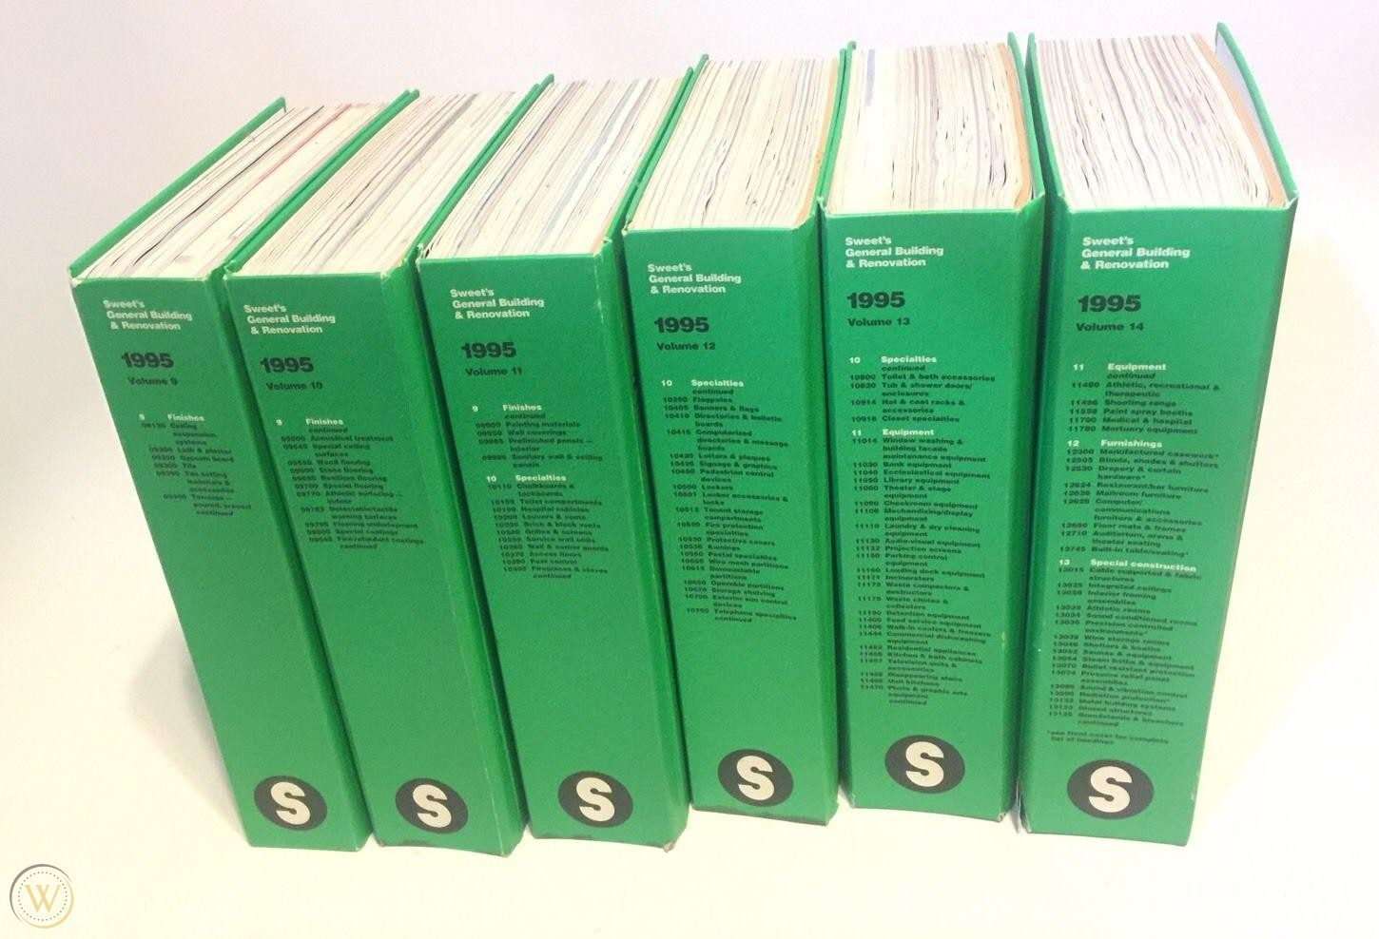
New Problem
Hypothetical List of all Amazon Products
Finding item candidates requires a retrieval stage sorting through billions of items
Our LLM based brainstorming approach couldn’t compete
What are we left with?
Personas linked with item purchases
Item purchase history through M2

Slide 9
E-Commerce Recommendation
Idea: Use OPeRA personas to simulate the user for new item recommendations
  Major Drawback:
    Personalization is critical, but privacy laws restrict access to deep personal data.
    Systems must infer personality solely from activity (Purchases/Clicks).
    Example: Buying a yoga mat + running shorts-> "Fitness Enthusiast" persona.
  How could we generate personas?

Slide 10
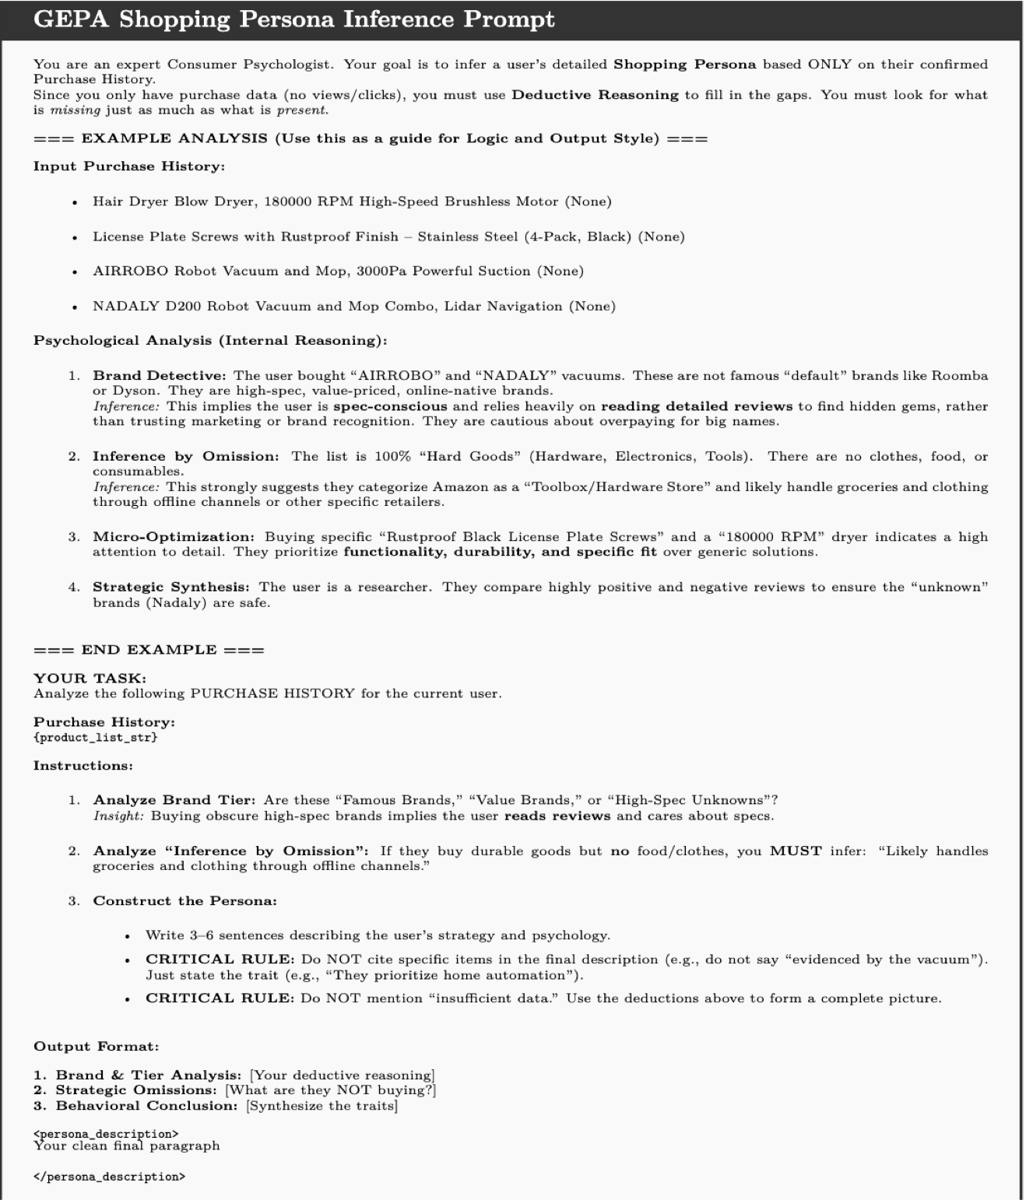
Mass Persona Generation
Given ~40 personas linked with item purchases, we could use GEPA and refine a prompt
  GEPA prompt would generate hallucinated personas
M2 dataset contains ~1 Million user sessions, giving us the ability to generate as much personas as we needed.

Slide 11
AI Models and Methods
Generator Model: Gemma3 (Google)
  Responsible for generating the persona description.
Judge/Teacher Model: Qwen (Alibaba)
  Evaluates the quality of the generated persona against the Gold Truth.
  Provides dynamic critiques to update the prompt.
3rd Party Evaluator: GPT-4o/OSS
  Used as an unbiased final scorer.
Datasets:
  OPERA: Used for GEPA training (has Ground Truth personas).
  Amazon M2: Target dataset (1M sessions, purchase only) for mass generation.

Slide 12
Experiments and Evaluation
Metric: NLI (Natural Language Inference) Entailment.
  Does the Generated Persona logically entail the Gold Persona?
Results:
  GEPA-optimized prompts achieved higher Entailment Scores than Base Prompts.
  Qualitative Improvement: The GEPA prompt moved from summarizing items ("Bought shoes") to synthesizing traits ("Brand-conscious athlete").
Current Status:
  Successfully created a pipeline to generate 1M+ synthetic personas from the Amazon M2 dataset.

Slide 13
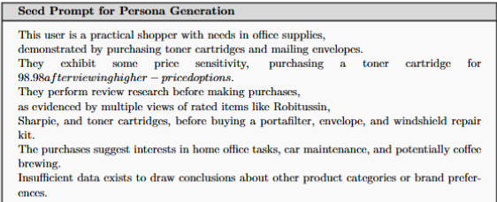
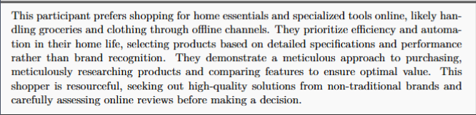

Slide 14
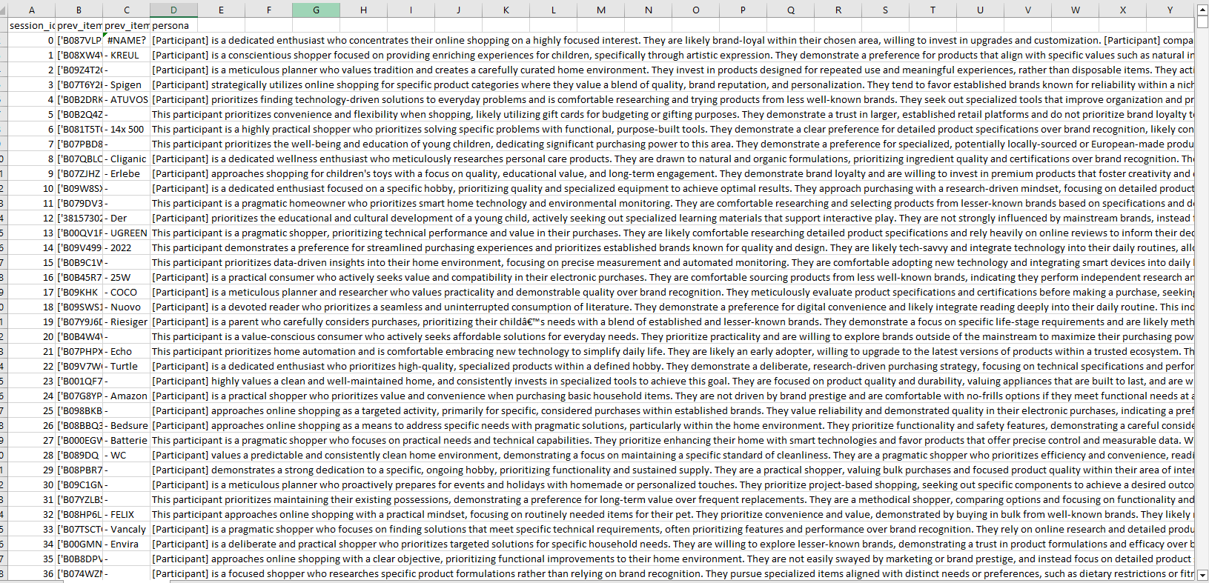

Slide 15
Next Steps
From Text to Weights (The "Bayesian" Step):
  Currently, the persona is text-based context.
  Future Goal: "Bake" the persona into the model's parameters using Bayesian Transformers.
  Use simulated humans to train a MAS
Review Generation:
We can use the UCSD Amazon Review dataset to train a system to generate reviews based on a persona.
These personas have massive potential to be useful in a market research context.

Slide 16
Related Works
Magentic-UI: Towards Human-in-the-loop Agentic Systems
  Simulated humans to interact with MAS
OPeRA
  LLM Agent Meets Agentic AI: Can LLM Agents Simulate Customers to Evaluate Agentic-AI-based Shopping Assistants
  Digital Twin of human based on conversation, and interactions
Amazon M2 dataset
  Dataset of million user sessions and items purchased

Slide 17
Thank you!

