Slide 1
Learned Per-Link Cache Lifetime for DSR in ns3
Alec Raymond

Slide 2
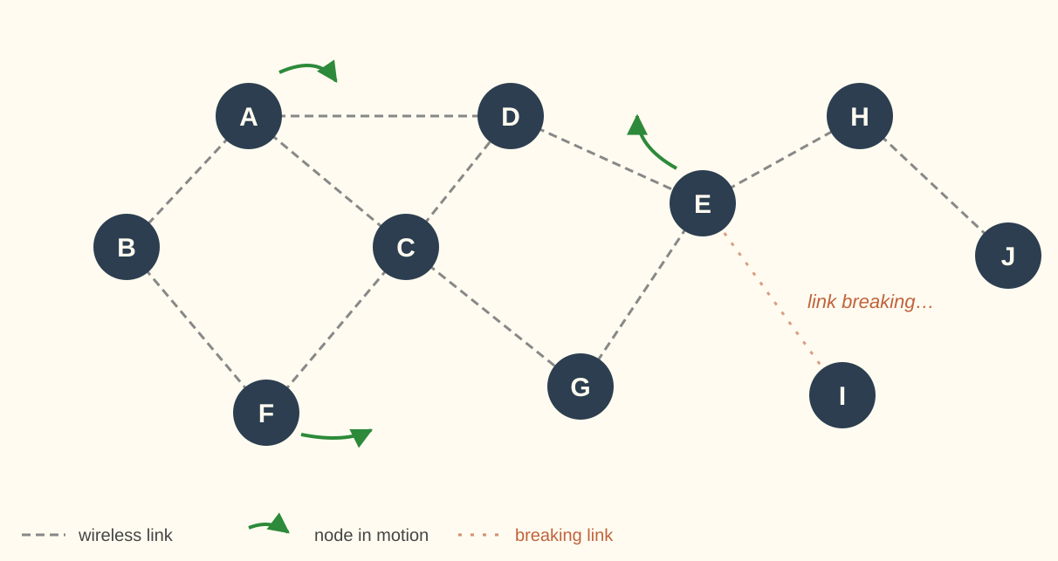
MANETs and Cached Routes
A MANET has no infrastructure, and nodes act as routers. Mobility constantly breaks links.
Each cached route has a lifetime, how long you can trust it before assuming it is stale.
Can you learn to predict that lifetime, based on what a node can observe?

Slide 3
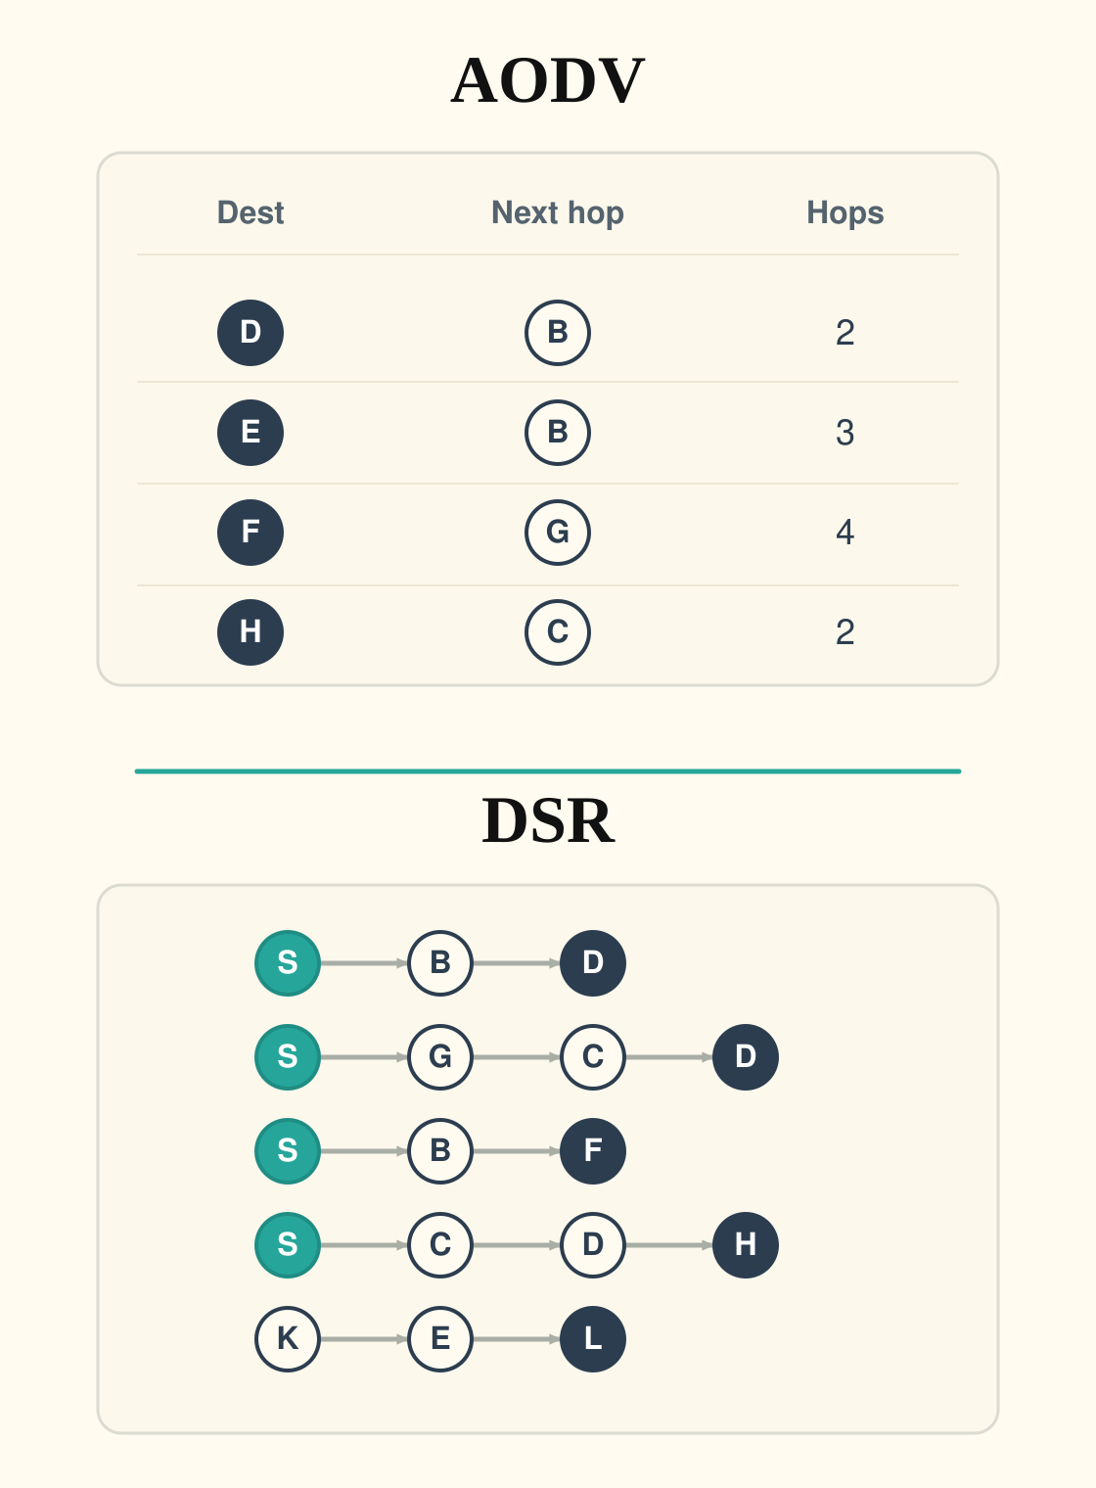
Reactive Routing Protocols
AODV: Table with next hop per destination
DSR: Cache of many multi hop routes, meaning it has many redundant routes
Each of these tables contains a TTL which removes a route from the cache after it has been in the cache for a certain amount of time.

Slide 4
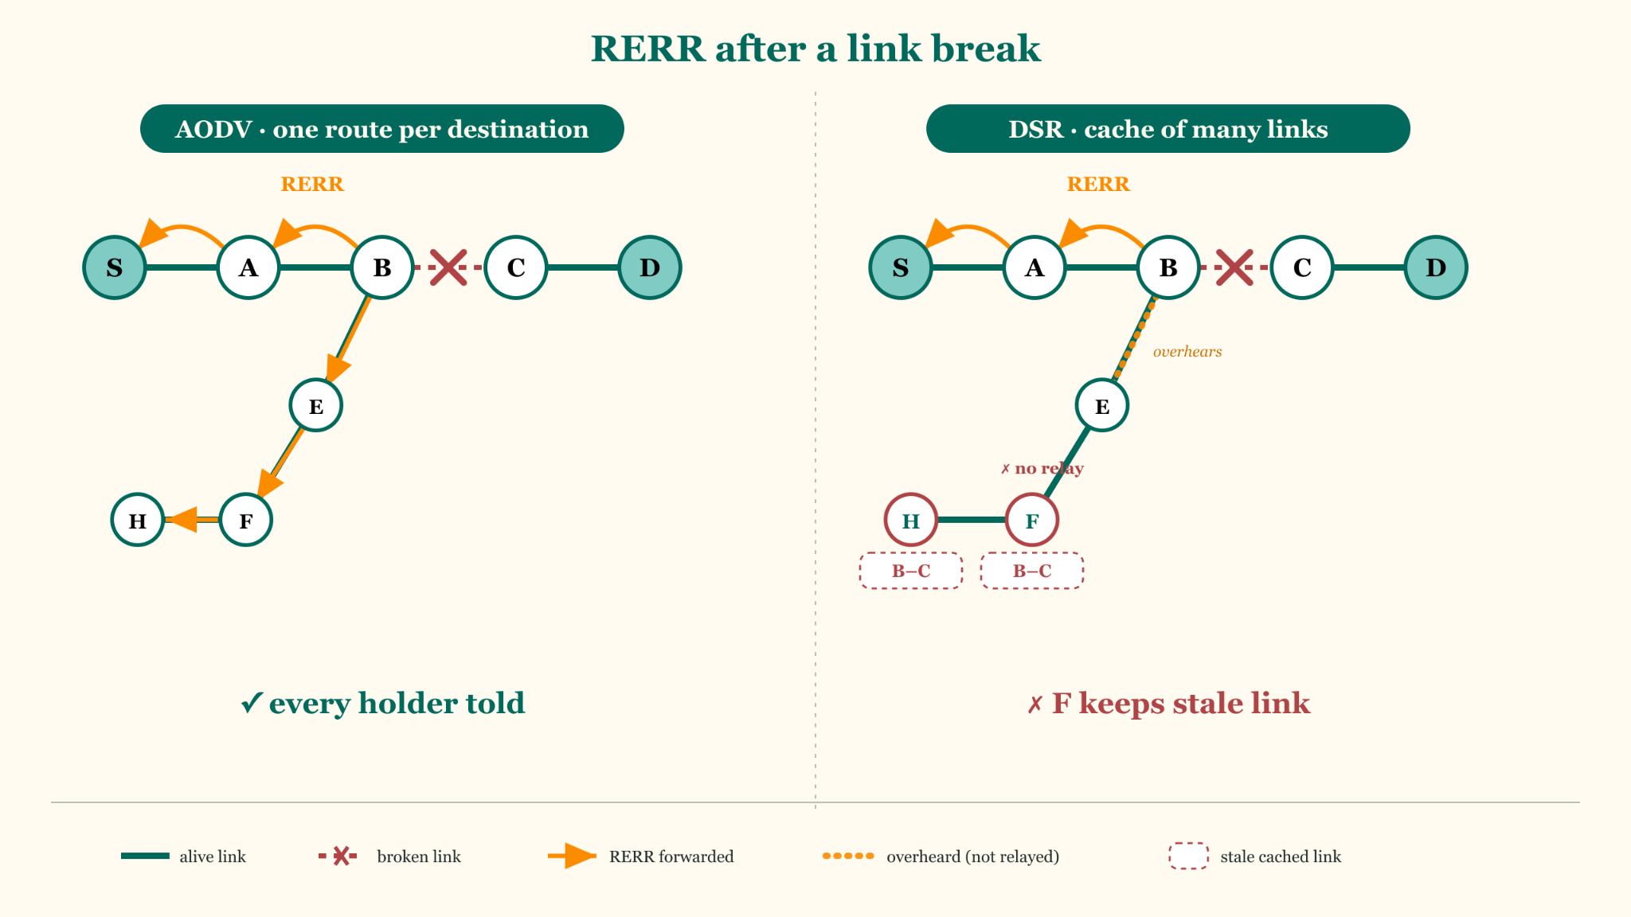
TTL isn’t the only signal
RERRs propagate differently in AODV and DSR.
If a link in AODV breaks, every predecessor is told
If a link in DSR breaks, the DSR is not guaranteed to cascade to every node which contains that link. This leads to stale

Slide 5
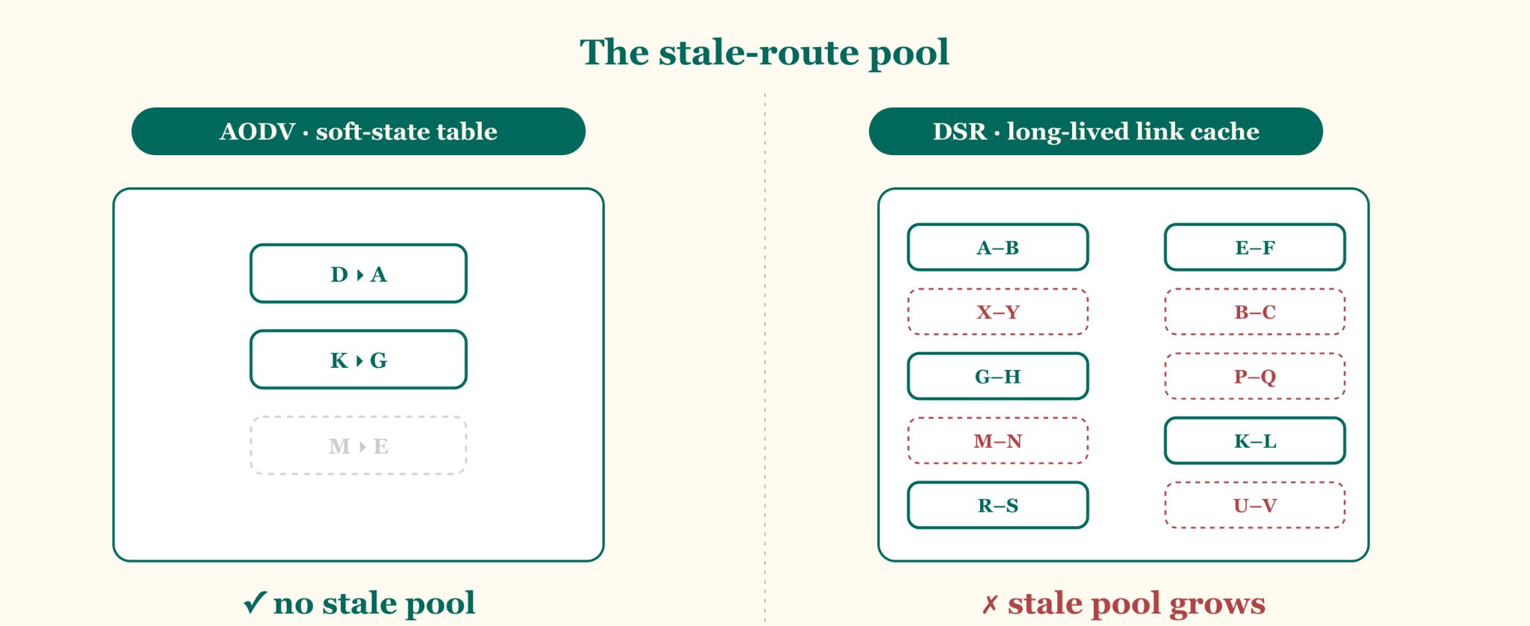
Stal

Slide 6
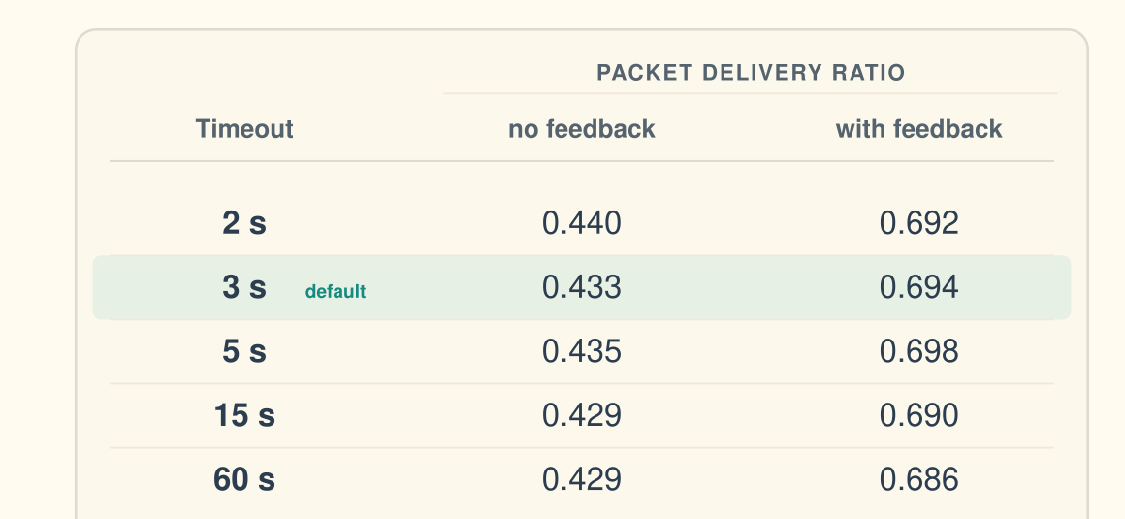
ACTIVE_ROUTE_TIMEOUT
I tried many different AODV route timeouts, and they barely affected Packet Delivery Ratio
With or without link layer feedback, changing timeout didn’t meaningfully affect network performance
PDR = # of packets received /
# of packets sent
AODV: Route Timeout vs. Delivery

Slide 7
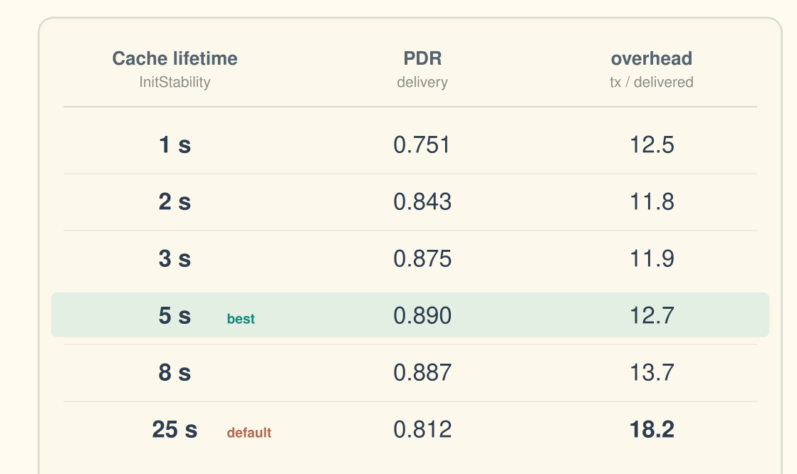
DSR
overhead = # of transmissions /
# of packets received
The cache lifetime meaningfully affects the performance of DSR, because stale routes pile up.
Here we isolated the initialization lifetime, setting UseExtends = 0
This allows us to see the real significance of different cache lifetimes.
DSR: Route Timeout vs. Delivery

Slide 8
Constant Cache Lifetimes
However, a single global constant can’t fit the spread of true link lifetimes:
In vanilla DSR, UseExtends extends a link’s lifetime as it is used (x4, /2)
In 2001, Liang & Haas created an analytical solution where they derived the optimal link lifetime. It calculates per route TTL by route hop count, otherwise treating every node as identical.
What doesn’t exist is a per link solution: Can you based on the statistics available to a node, calculate a lifetime for the statistics each node knows about that link?

Slide 9
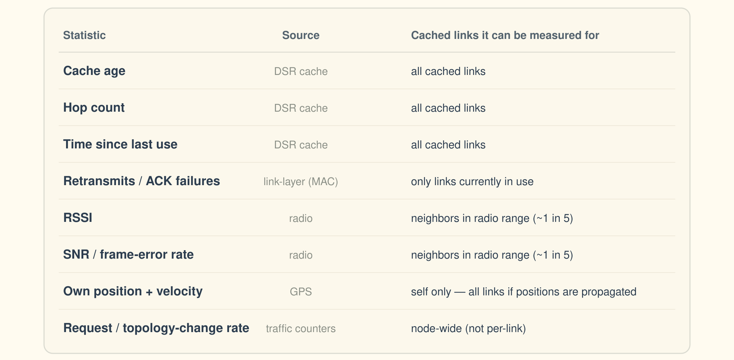
Potentially Learnable Metrics

Slide 10
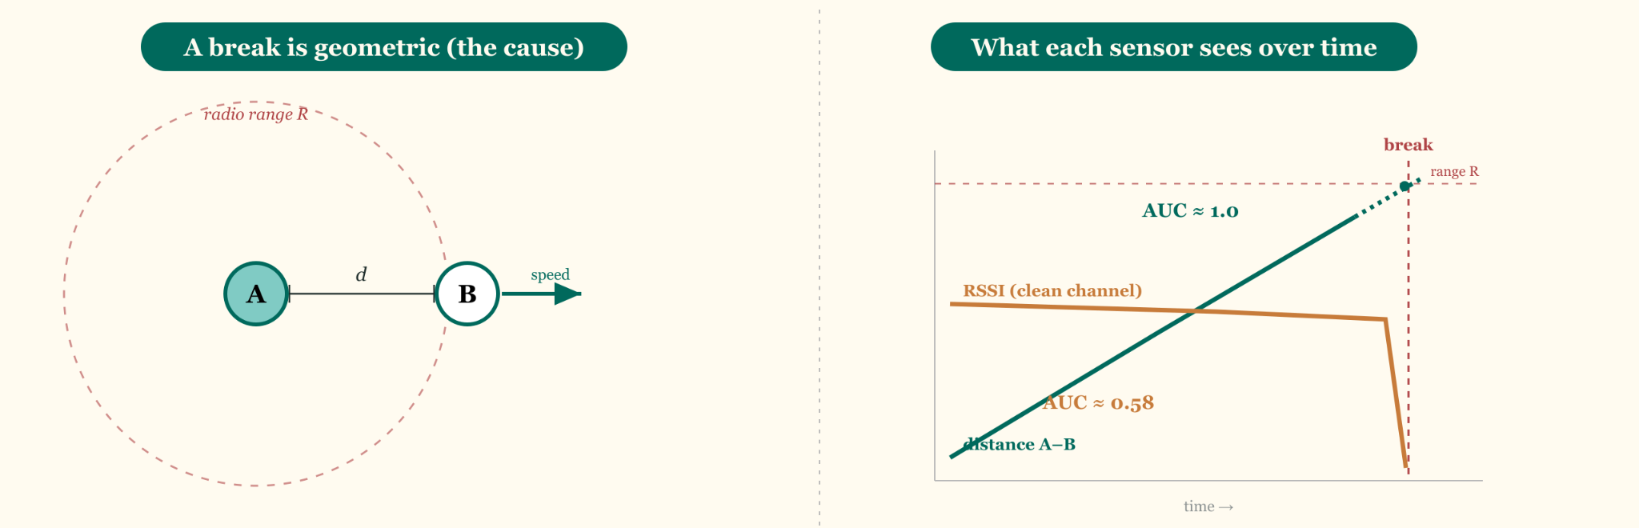
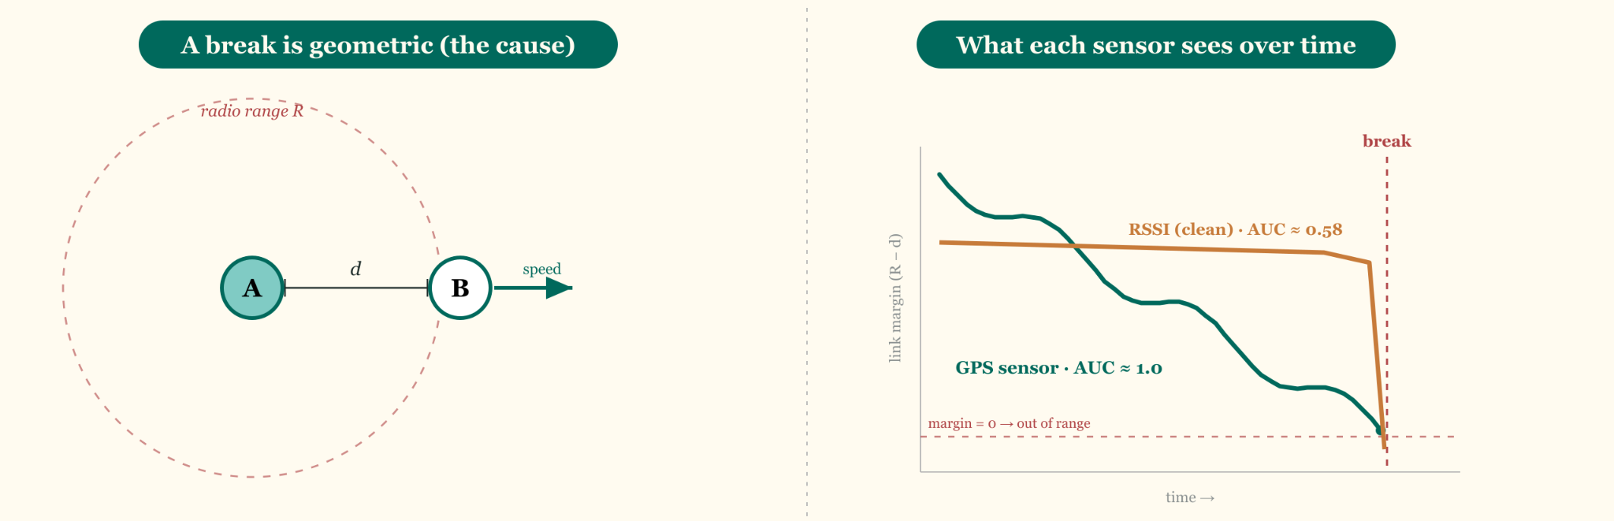
Node mobility determines link breaks

Slide 11
GPS Simulation and Propagation
Each node maintains in its cache the (position, velocity) of every other node with the most recent observation time.
For each packet it sends, it attaches to the header its own position and velocity.
  The position is muddied with Gaussian error to simulate GPS error, velocity isn’t changed
It also attaches all of the positions and velocities it knows of other nodes, as well as when they were observed.
This allows gossip to propagate of where nodes are and where they are going

Slide 12
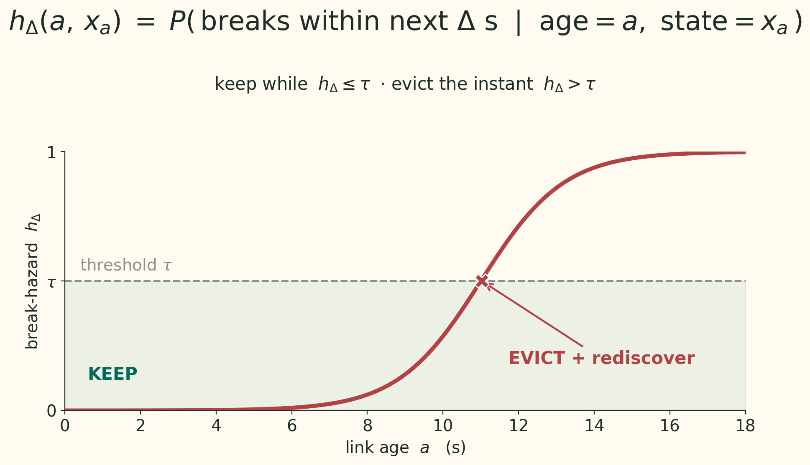
Continuous Keep or Kill
Having learning distributed per node allows us to make a key improvement over setting a static TTL.
We can continuously predict the probability of a break, and adjust the TTL prediction.

Slide 13
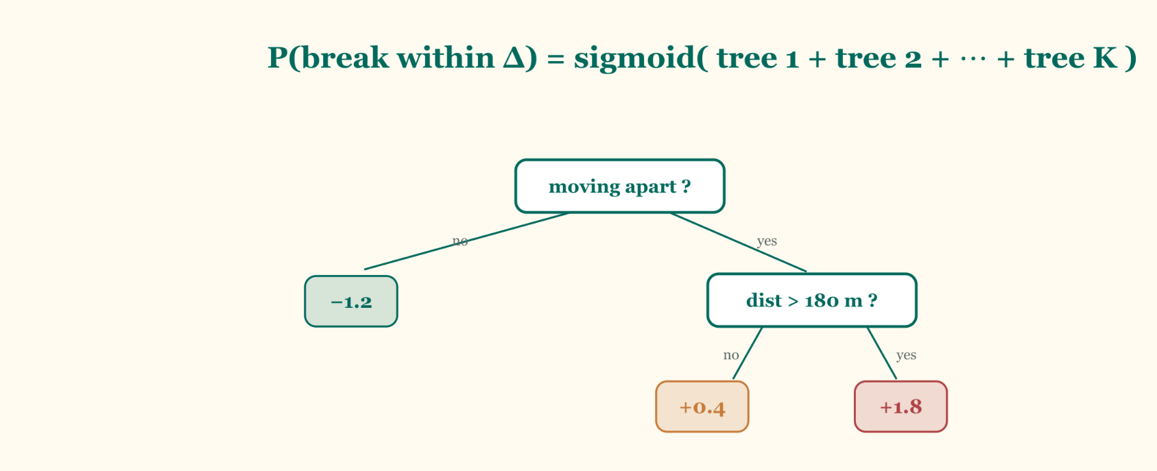
LightGBM
Light Gradient-Boosting Machine is an “efficient tree based learning algorithm for large scale data”
Each tree is trained to follow the gradient of the loss
Since it uses a bunch of decision trees, inference is just a bunch of comparisons and additions, making
Notes:
https://lightgbm.readthedocs.io/en/latest/index.html

Slide 14
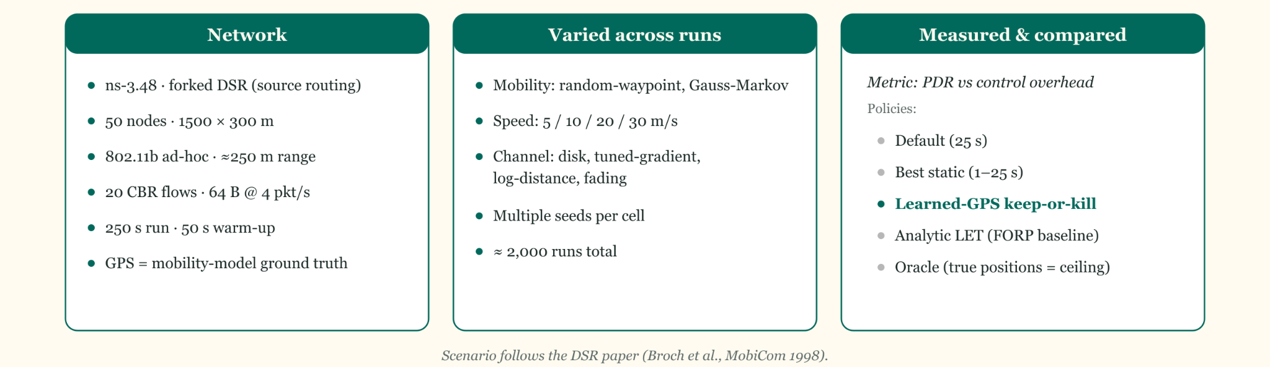
ns3 Simulation Scenarios
Discrete-Event Network Simulator
20
Notes:
Event queue advances virtual clock

Slide 15
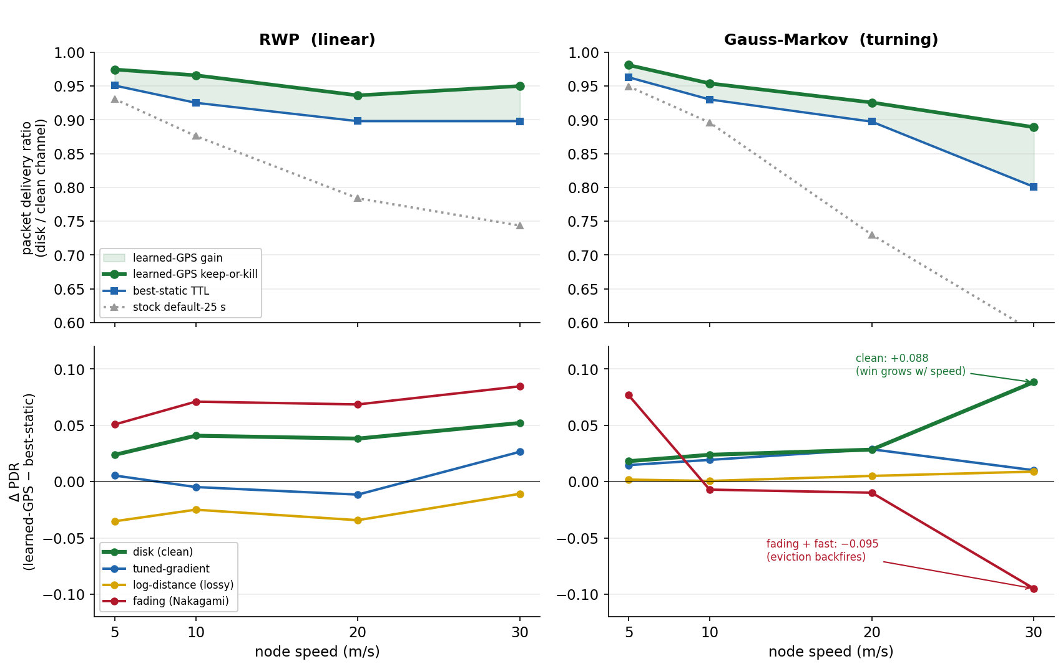
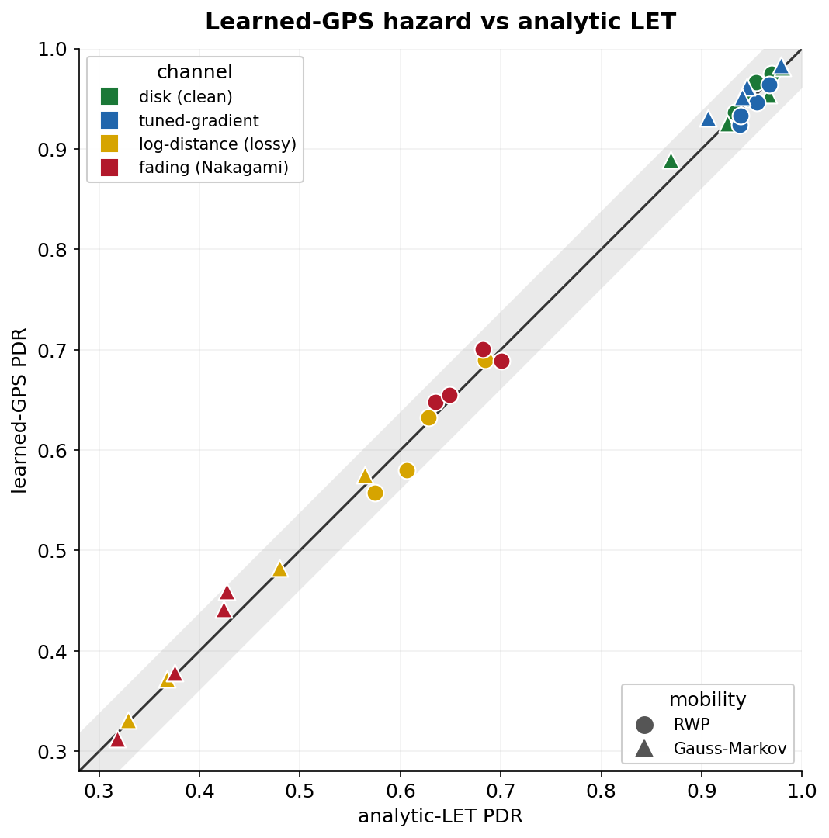
Results

Slide 16
Conclusions
The biggest limitation is the reliance on GPS data, many nodes do not have GPS capabilities.
The cache lifetime is a rather minor statistic for reactive MANET protocols, especially AODV, because the route rediscovery is such a huge part of these protocols.
By propagating GPS data, I was able to match, and maybe slightly improve upon prior methods
This could have some applications in VANETs, but my predictor needs to improve
  I need to better understand the current landscape of VANET GPS based protocols
  Online prediction could tune model performance to the current network landscape

Slide 17
Thanks!

