Slide 1
Machine Learning for MANETs
Deep Learning for MANET Routing (2023)
DeepCQ+ (MILCOM 2021)
Hypergraph-Based Routing in SDVNs (TMC 2025)
By Alec Raymond

Slide 2
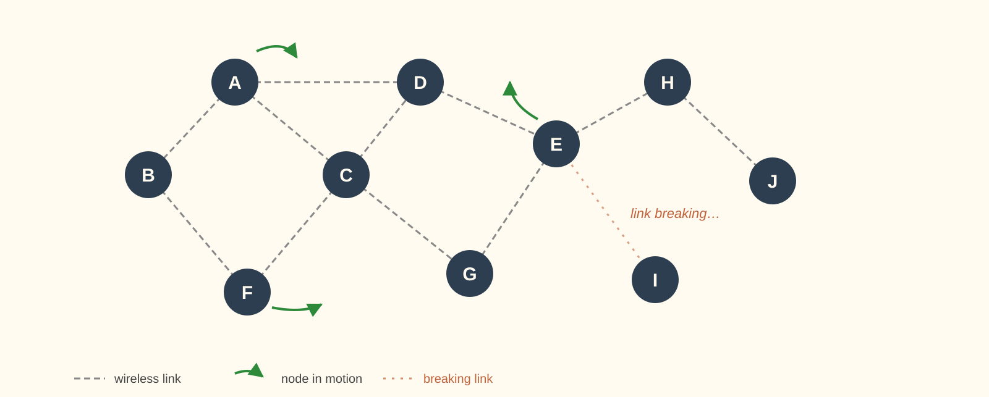
Mobile Ad hoc Networks
Notes:
No fixed infrastructure: Each node acts as a router, nodes can join and leave freely, routing becomes much more challenging because the network topology changes dynamically, links are unstable,

Slide 3
Classical Protocols
AODV, OLSR, and DSDV make routing decisions based on manually designed metrics and rules:
Hop Count
Sequence Number, Freshness Timer
Hand-Tuned Thresholds (TTL, HELLO interval, broadcast probability)
Limitations:
- Thresholds tuned for one scenario don't fit another (low mobility ≠ high mobility).
- Often ignore richer network information (link reliability, congestion, multi-hop relationships, future availability.)
- Some MANET optimization problems (e.g., joint routing, scheduling, and power control) are NP-hard, making fixed rules and heuristics difficult to optimize effectively.
Notes:
Traditional MANET routing protocols such as AODV, OLSR, and DSDV make routing decisions based on manually designed metrics and heuristics, such as …..
…
These protocols work well in specific scenarios, but may not generalize well to different network conditions.

Slide 4
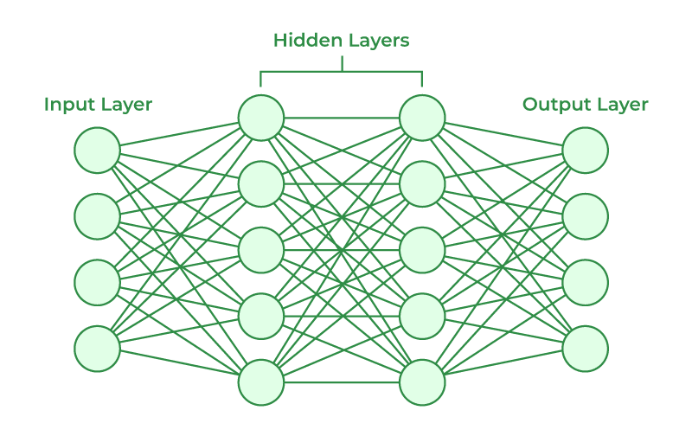
Why Machine Learning?
ML enables routing protocols to:
utilize richer network information, to
learn adaptive routing policies, which
react dynamically to changing network conditions, and
calculate quickly.
Network information used | Reason | Paper
C/H value trends and recent broadcasts | Learns when to broadcast vs. when to unicast | DeepCQ+
Hypergraph link structure and traffic history | Fast hypergraph routing | Hypergraph SDVN
Requests, topology, routes | Approximate NP-Hard scheduling decisions in real time | SPCDNet
Notes:
Instead of relying on fixed heuristics, machine learning approaches can incorporate richer network information into routing decisions.
For example, some methods focus on temporal information and try to learn how network conditions evolve over time. Others use graph or hypergraph structures to capture more complex relationships between nodes. Some approaches also attempt to approximate computationally difficult optimization problems in real time.
Overall, the key idea of ML is to make routing more adaptive and data-driven.

Slide 5
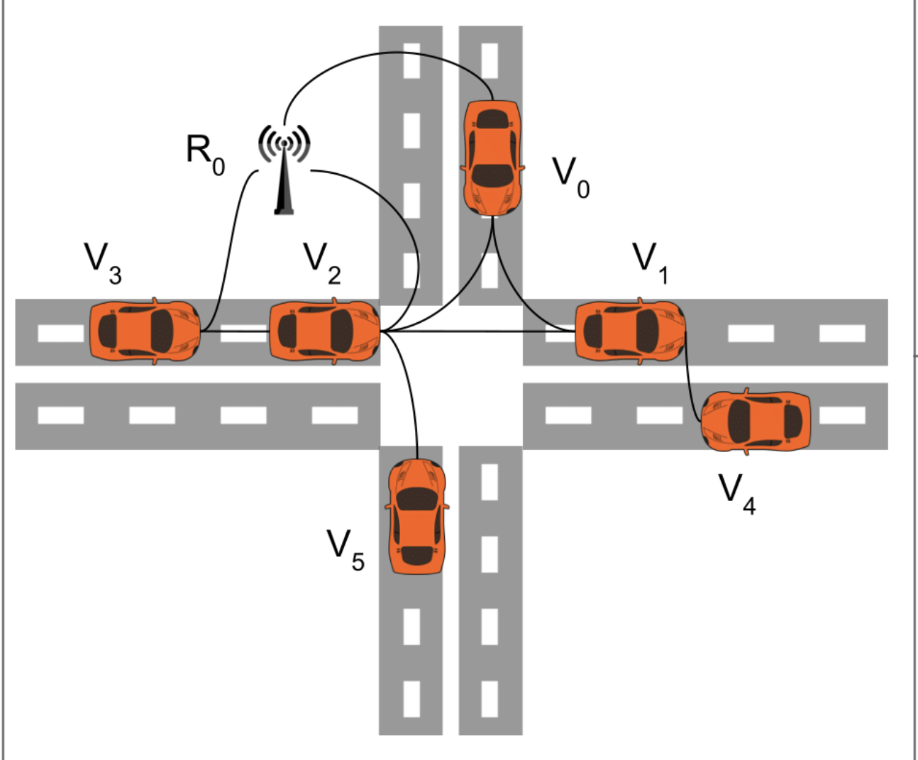
From Distributed to Centralized
VANETs: cars and roadside towers, communicating wirelessly
Mobility is aggressive with fixed roadside infrastructure
Software defined network puts a controller in charge: it sees the whole network and pushes routing decisions down to the devices.
Nahar et al. 2025 — Hypergraph DRL for VANETs
Vehicles <-> Roadside Towers <-> SDN Controller
Wireless Wired

Slide 6
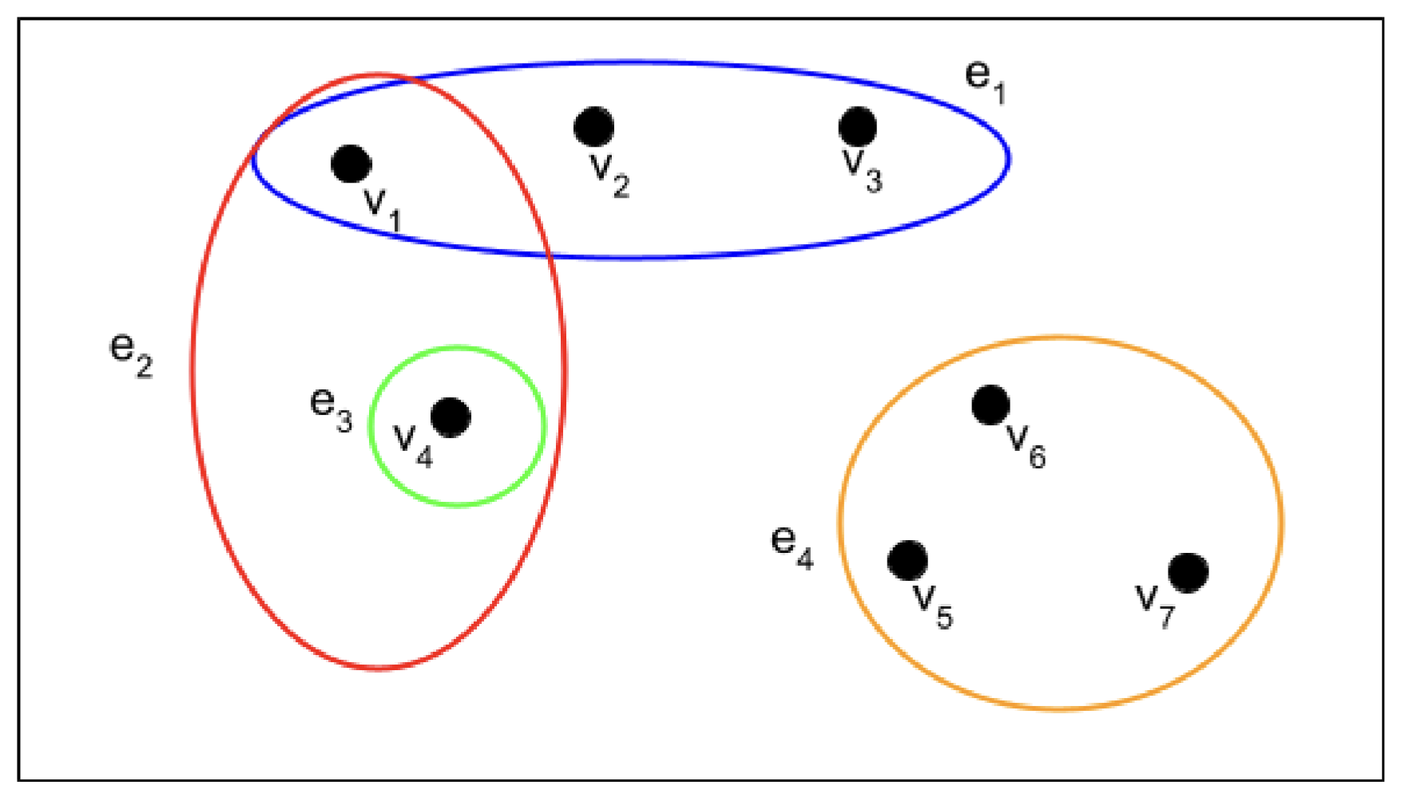
What is a Hypergraph?
- H = (V, E): vertices V, hyperedges E
- Each hyperedge e ∈ E can connect multiple vertices
- Singletons not allowed

Slide 7
Comparing Approaches
Hypergraphs
- Communication is naturally multi-way (broadcasts, clusters)
- Links fail together(shared channel, interference)
- Network is dense with many simultaneous links
Pairwise Graphs
- Mostly point-to-point links
- Standard algorithms (Dijkstra, BFS) are enough
- Sparse network — no compression benefit
In the paper’s 16-node test, the same network has 66 edges as a graph but only 17 hyperedges. Average node degree drops from 8 to 4.

Slide 8
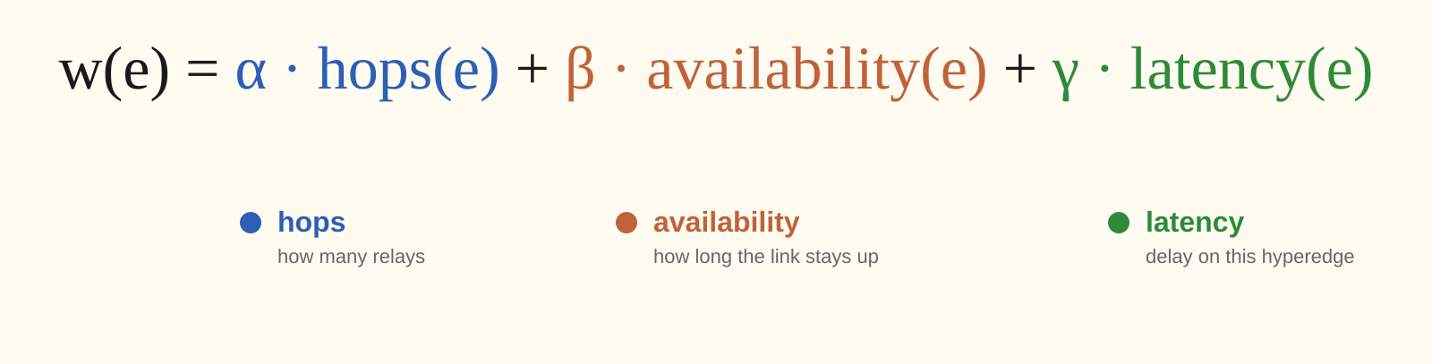
Weighted Hypergraphs
Each hyperedge has a non-negative weight that represents its cost as a routing choice.

Slide 9
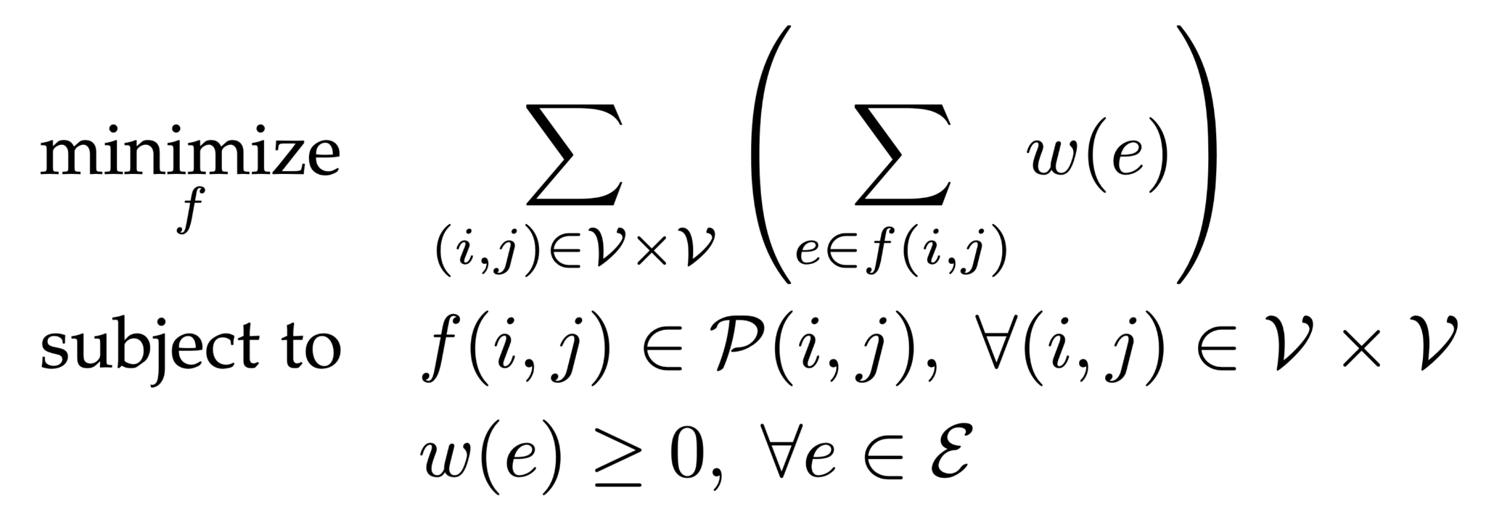
Routing as Constrained Minimization
- For every (source → destination) pair, pick a path
- Path Cost = sum of its hyperedges' weights (inner Σ); Total Cost = sum across all pairs (outer Σ)
- Minimize the total, subject to feasibility and non-negative weights

Slide 10
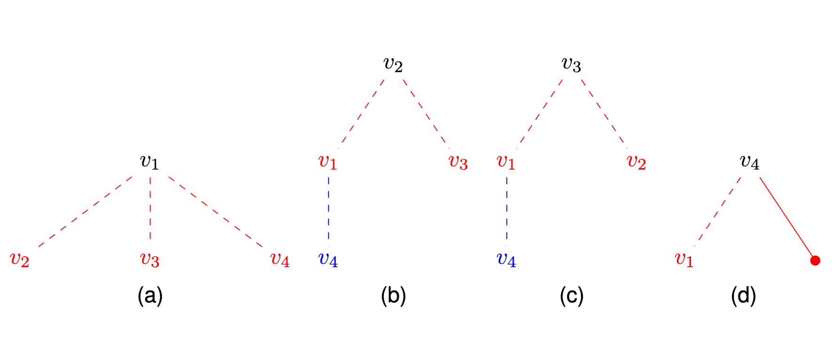
What about Tree Search?
Tree Search on a hypergraph is polynomial time
Why use DRL?
Notes:
Strong answers to encourage:
- "Topology is too dynamic" → headline reason. Confirm and elaborate.
- "You don't know the availability ahead of time" → excellent. This is the subtle one that most students miss.
- "You'd have to re-run Dijkstra constantly" → the scale point. Acknowledge.
Answers to gently correct:
- "Tree search doesn't work on hypergraphs" → "Actually it does. The paper even constructs the tree in Figure 3. The
issue isn't computability — it's that classical algorithms finish too late."
- "It's NP-hard" → "For a single source-destination pair with the scalar w(e), it's polynomial. Multi-criteria or
multi-commodity arguments would make it NP-hard, but the paper collapsed to a scalar."
Answers worth exploring:
- "Hypergraph shortest path is harder than graph shortest path" → "Slightly — there are polynomial algorithms but they're
less standardized than Dijkstra. Acknowledged, but it's not the load-bearing reason."

Slide 11
Why DRL?
1. Dynamics — topology changes faster than you can re-solve
2. Weights require future prediction — availability depends on where cars will be
3. Constant Recalculation — every flow, every topology change, every 22 ms

Slide 12
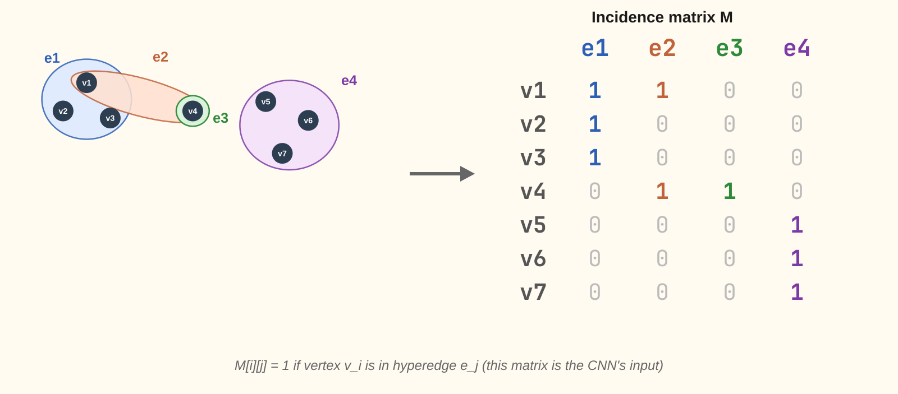
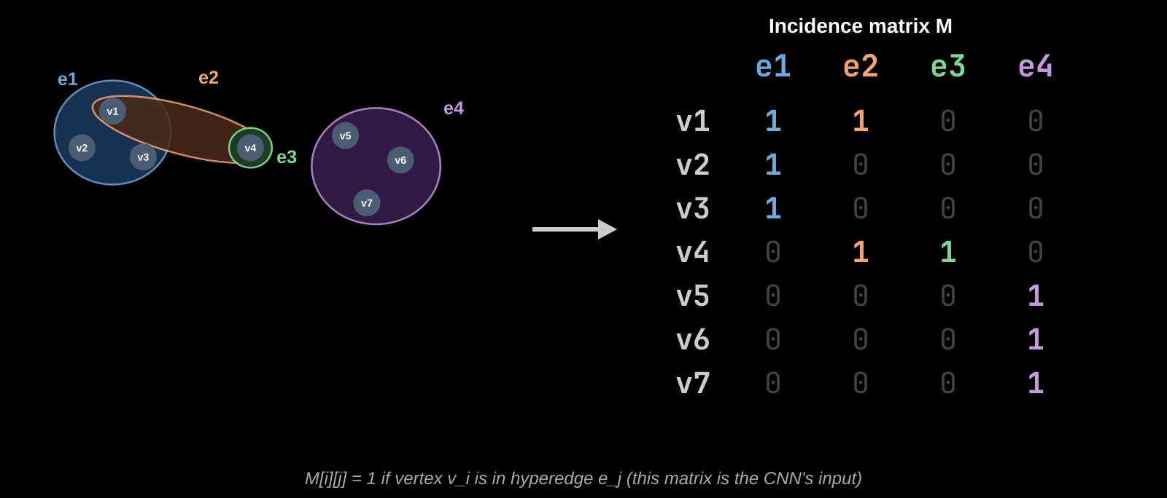
Matrix Representation of a Hypergraph

Slide 13
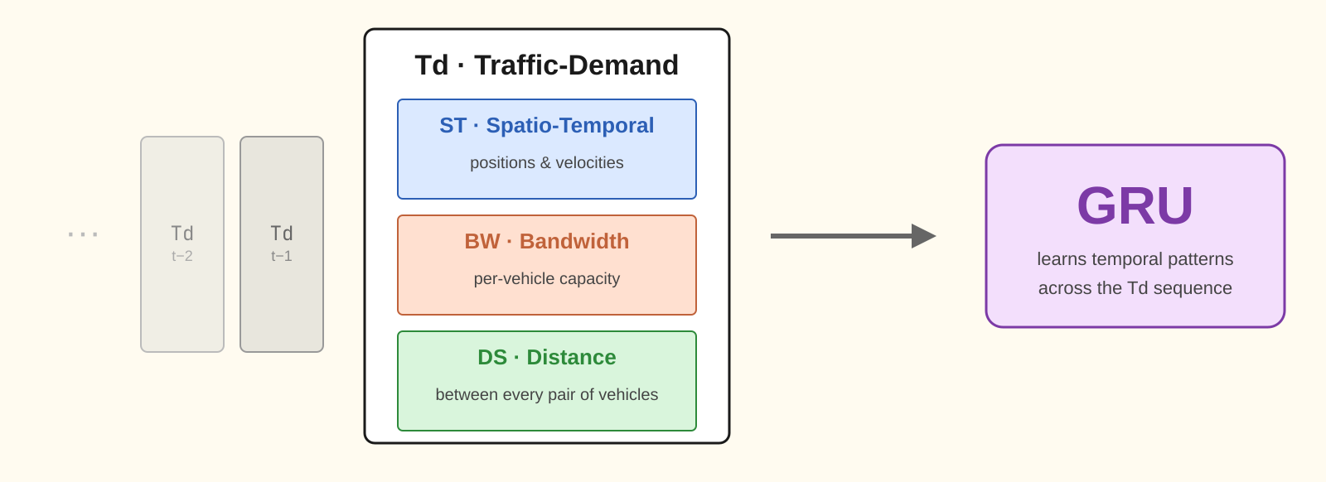
The Other Input

Slide 14
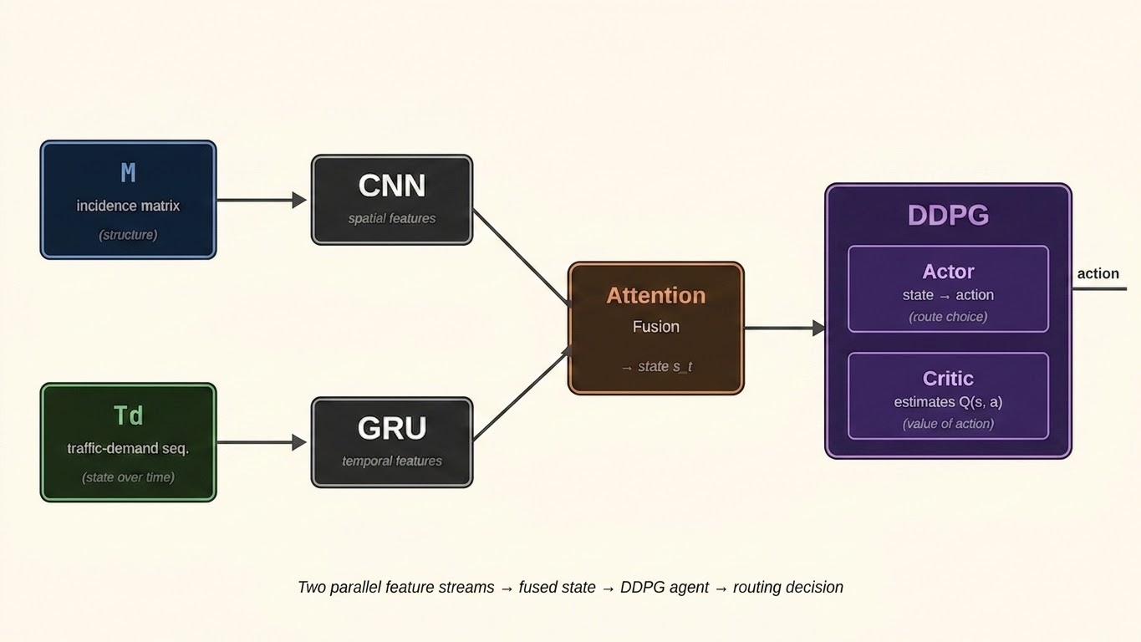
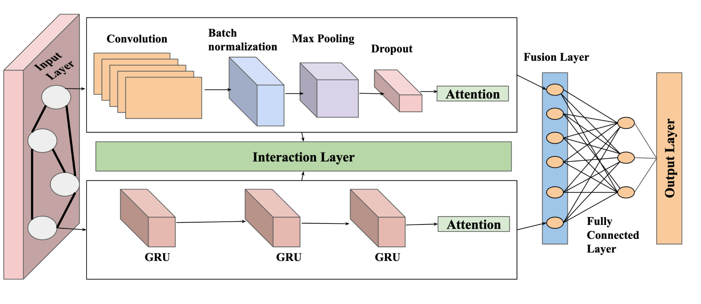
The Pipeline
Notes:
Convolution is good for recognizing patterns (matrix rendered as an image)
A GRU carries a hidden state (the memory of previous temporal changes) which allows it to understand patterns
The output layer is a routing action (which hyperedge sequence to take)

Slide 15
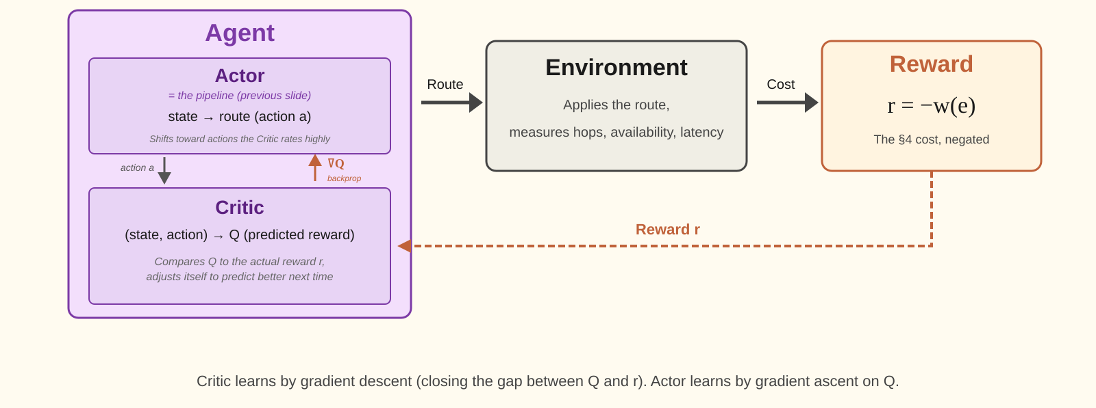
Deep Reinforcement Learning
Notes:
DDPG: Q is learned by regressing the critic toward r + γ·Q'(s′, μ'(s′)) — the reward plus the discounted value of the next state, where the actor picks the next action so you avoid the intractable max over continuous actions.

Slide 16
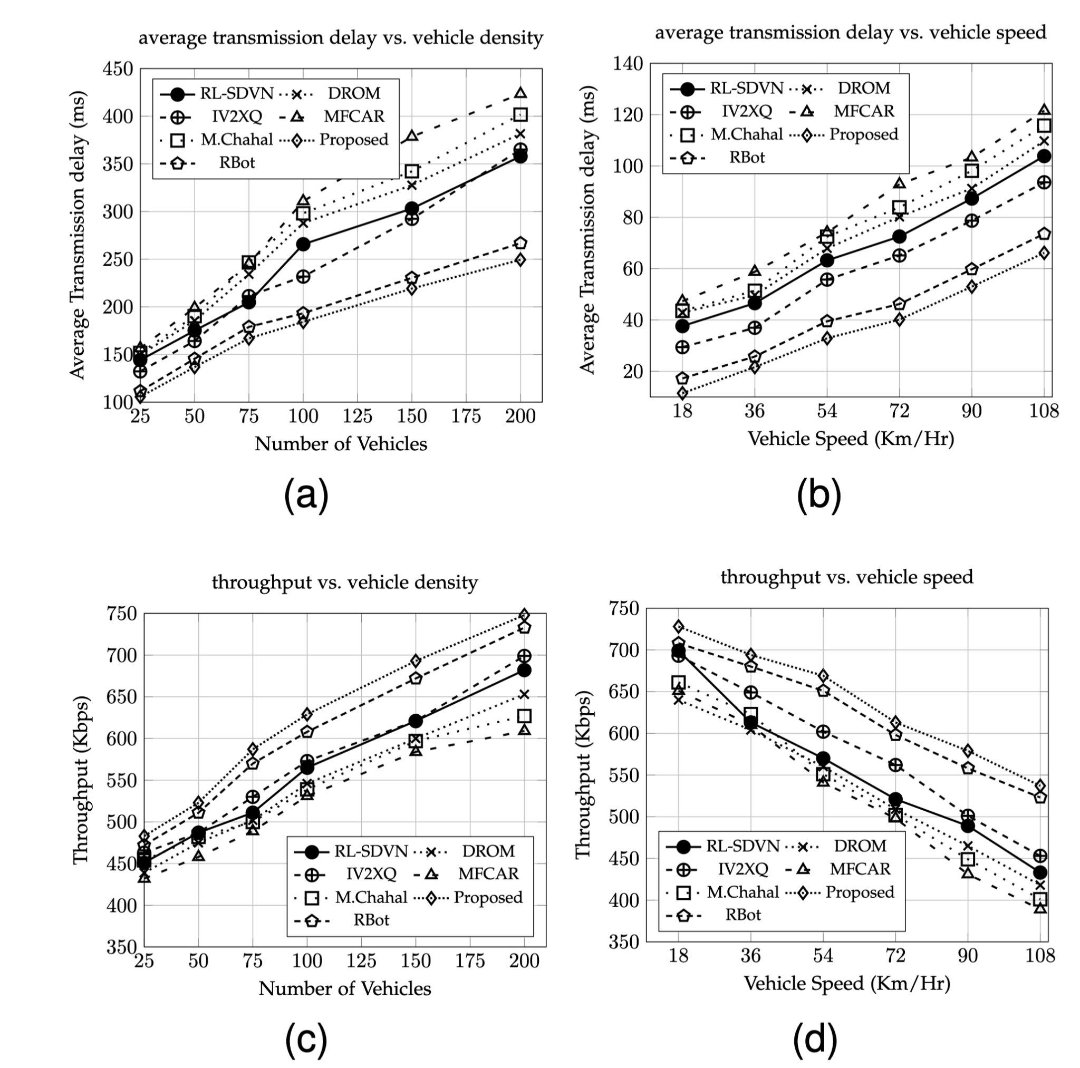
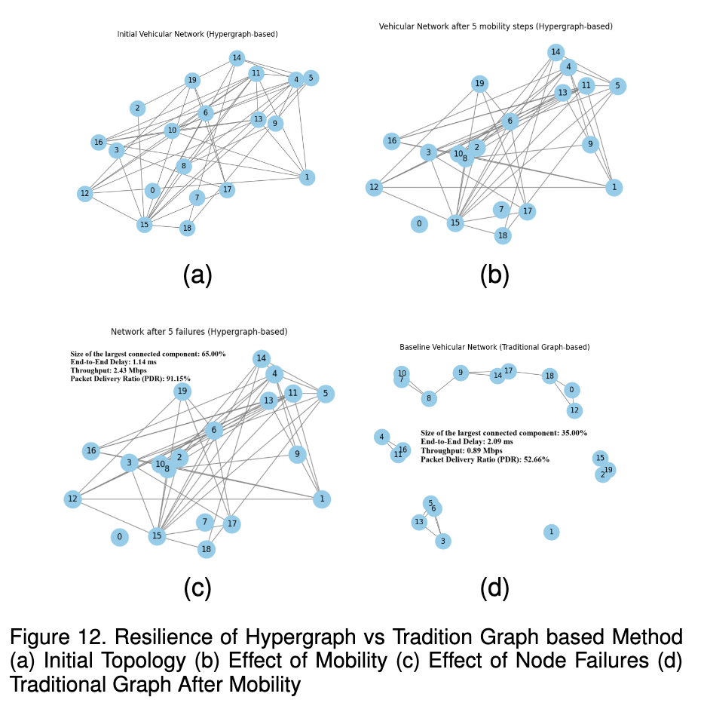
Results
22 ms per routing decision (30-60 ms competition
Notes:
Latency and Throughput

Slide 17
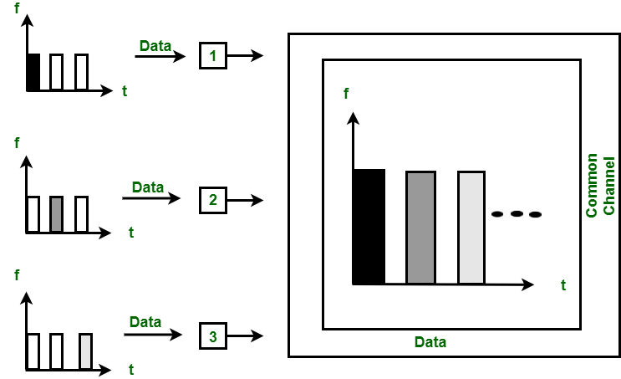
Compression of the Approximate Optimal
TDMA: Time Slotted Schedule, with links transmitting at each slot. Nodes transmit when powered on. When to power each node?
This problem is NP-Hard, but can be relaxed into a Linear Program.
The DNN is then trained on solved LPs, approximating their solutions

Slide 18
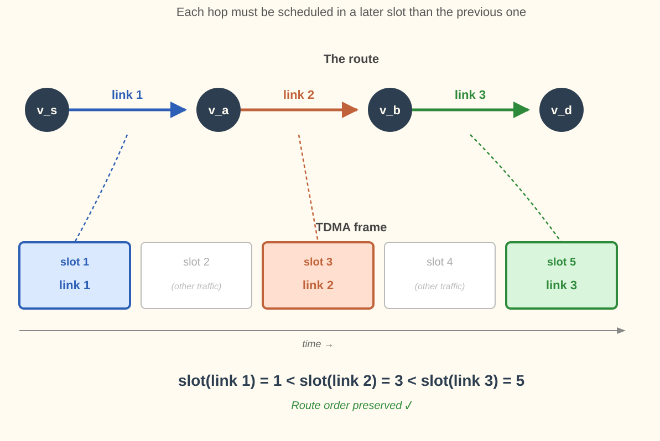
SPCDNet^{R}: Routes as inputs
New input: pre-calculated routes.
New constraint: The schedule must respect route order.
How would you enforce route order?
Hint: How would you change the input of the DNN?

Slide 19
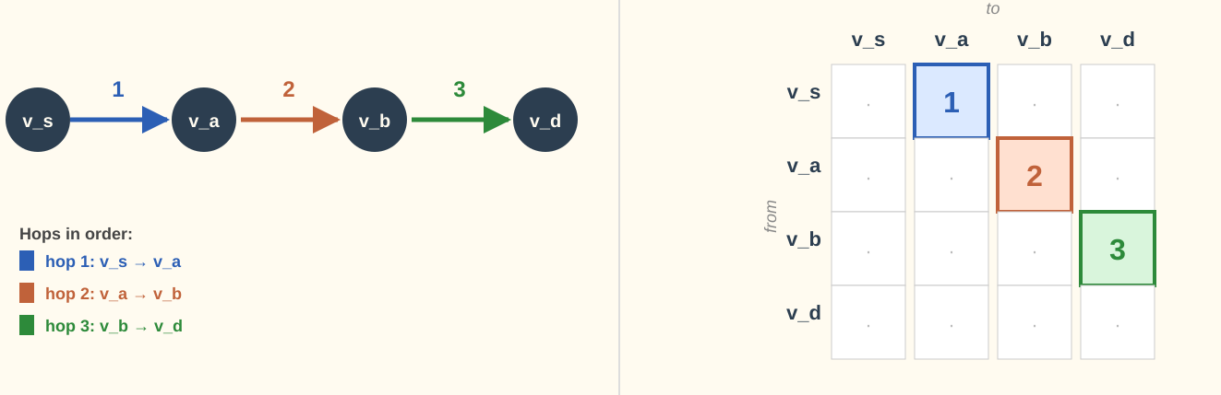
Encoding Routes
For each route, in order, a route matrix is appended to the DNN input.
Instead of penalizing out-of-order routes in the loss function, the structure of the DNN is conditioned by the input.
Notes:
Then, the new LPs are solved, which gives the training data for SPCDNet^R

Slide 20
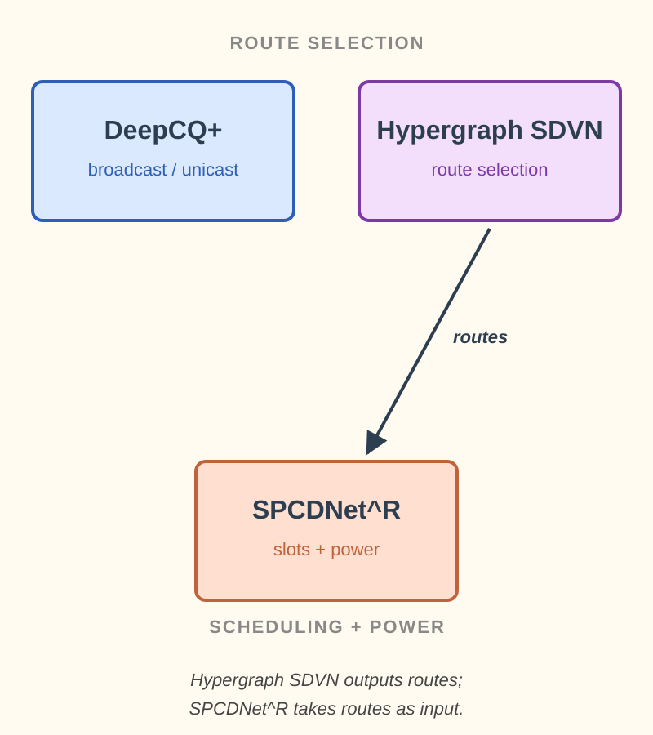
Composing ML Approaches
- Cutting edge machine learning pipelines break down complex problems into smaller subproblems which specialized models can be trained to solve on.
- ML models amortize compute time by front-loading computation during training, then reusing the learned parameters cheaply at inference.
- Instead of relying on incomplete heuristics, ML allows networking protocols to approximate optimal solutions at real time speeds.
Notes:
For networking and in general, ML is about finding interesting ways of organizing a problem into subproblems which lend themselves to certain ML architectures.

Slide 21
Thank you!
Any questions?
:)

